Slide 1
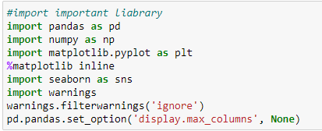
Import Important Liabrary

Slide 2
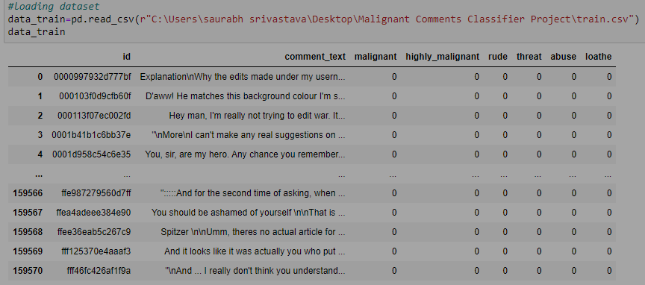
Training Data

Slide 3
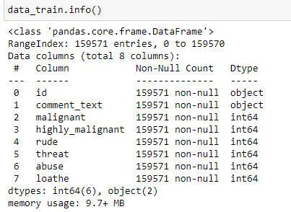
Training data info

Slide 4
Features
Comment_text taken as Input feature
Malignant, highly malignant, rude,threat,abuse,loathe are target variable.
Input feature dtype is object.
Target variable dtype is integer.

Slide 5
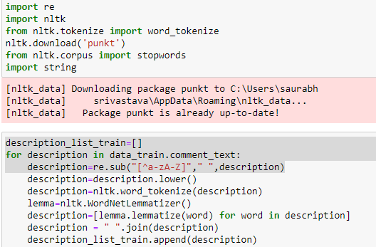
Data Preprocessing

Slide 6
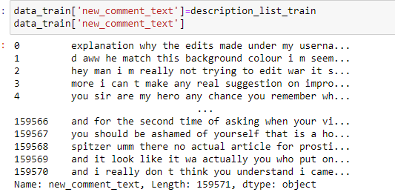
Contd….

Slide 7
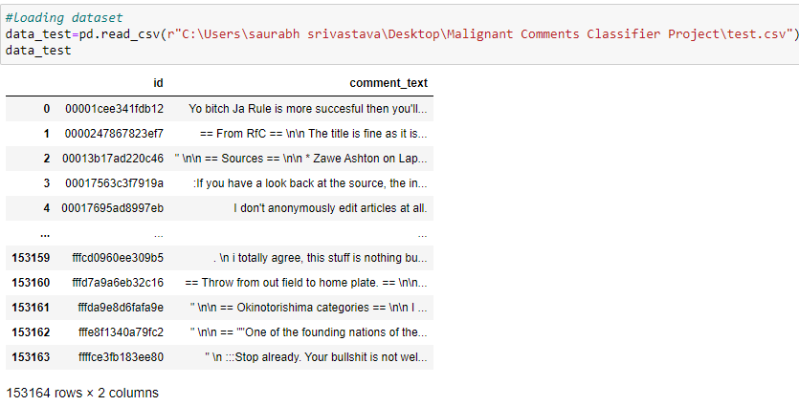
Loading Test data

Slide 8
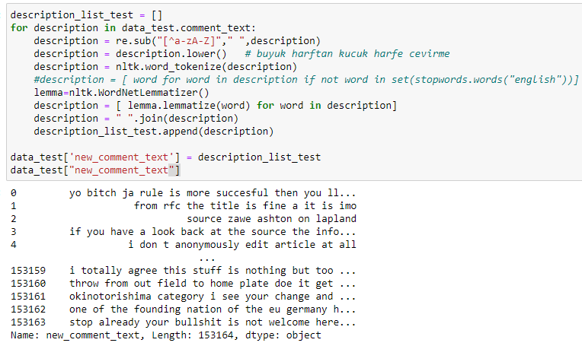
Preprocessing for Test Data

Slide 9
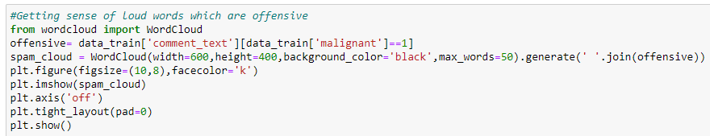
Data Visualization for Text

Slide 10
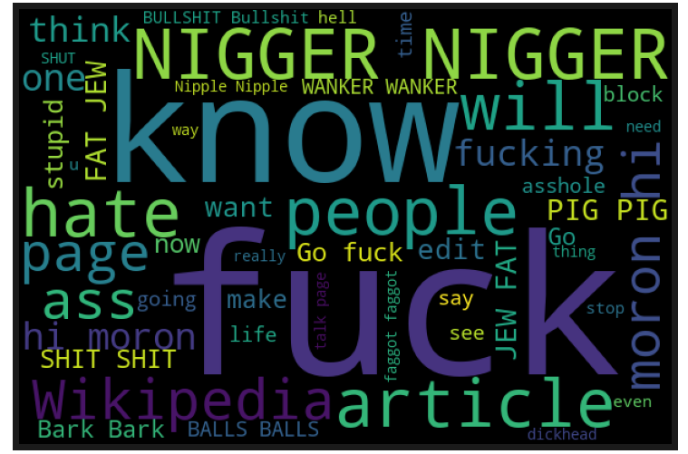

Slide 11
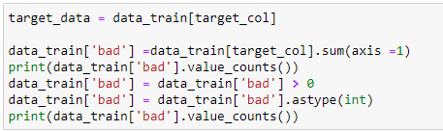
Creating new Target Column

Slide 12

Convert text into vectors using TF-IDF

Slide 13

Importing train test split

Slide 14
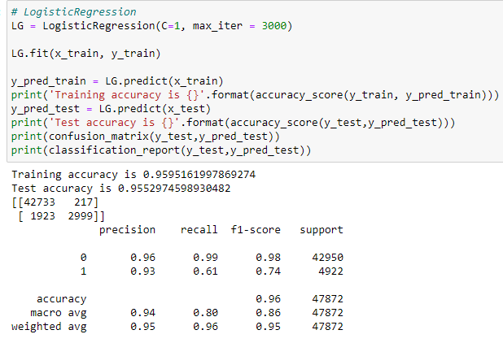
Model Building & Evaluation metrics
Logistic Regression

Slide 15
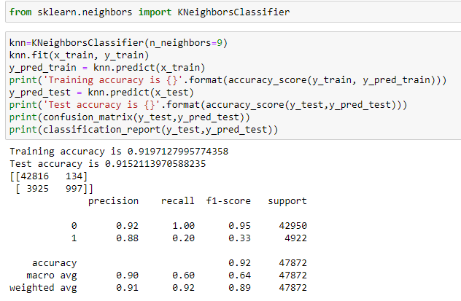
KNeighborsClassifier

Slide 16
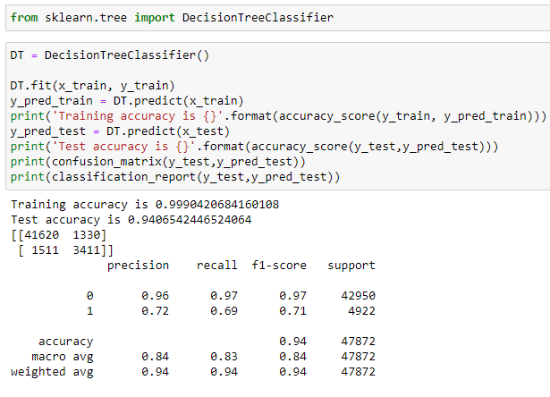
DecisionTreeClassifier

Slide 17
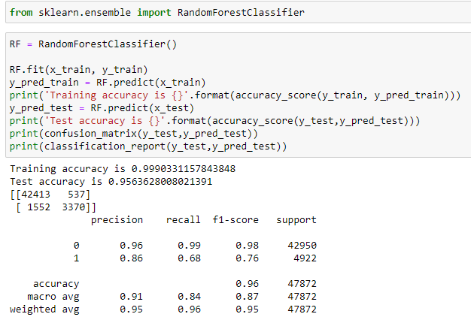
RandomForestClassifier

Slide 18
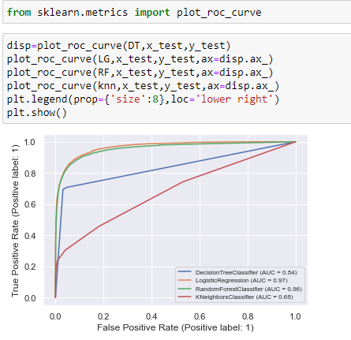
Roc_auc_curve

Slide 19
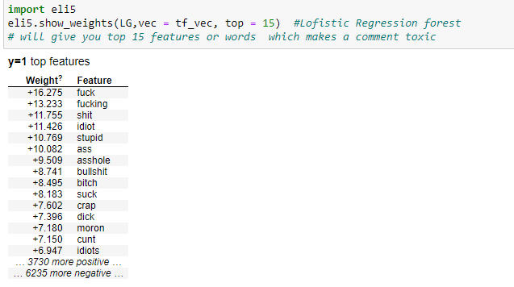
Important Features

Slide 20
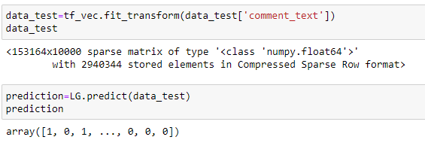
Predicting of test result

Slide 21

Saving model

